Slide 1
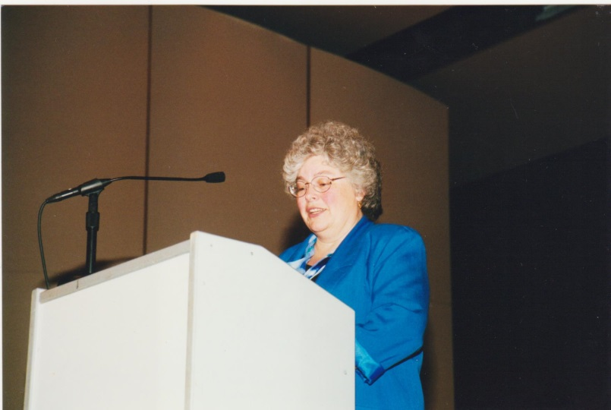
ANNE TURNER IN VOLUNTEER MANAGEMENT

Slide 2
ANNE WAS A BELIEVER IN the power of people and community!

Slide 3
ANNE WAS THE DIRECTOR OF
THE VOLUNTEER CENTER
(now known as Volunteer Connections)
FOR OVER 20 YEARS AND A SUPPORTER OF ALL VOLUNTEER EFFORTS IN CLARK COUNTY!!
She was very involved in helping move RSVP to the Human Services Council and also served on the DVPA Board for many years
(primarily as Treasurer & Secretary 1998 - 2005)!!

Slide 4
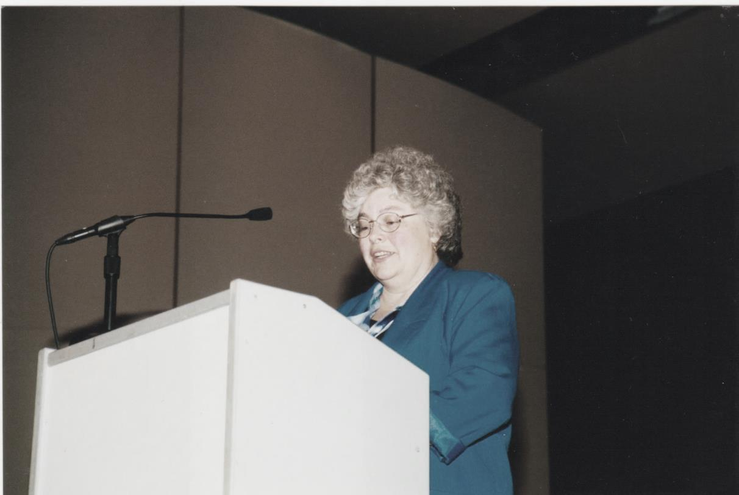
ANNE COORDINATED MANY EVENTS FOR CLARK COUNTY
INCLUDING AN ALL COUNTY RECOGNITION FOR VOLUNTEERS

Slide 5
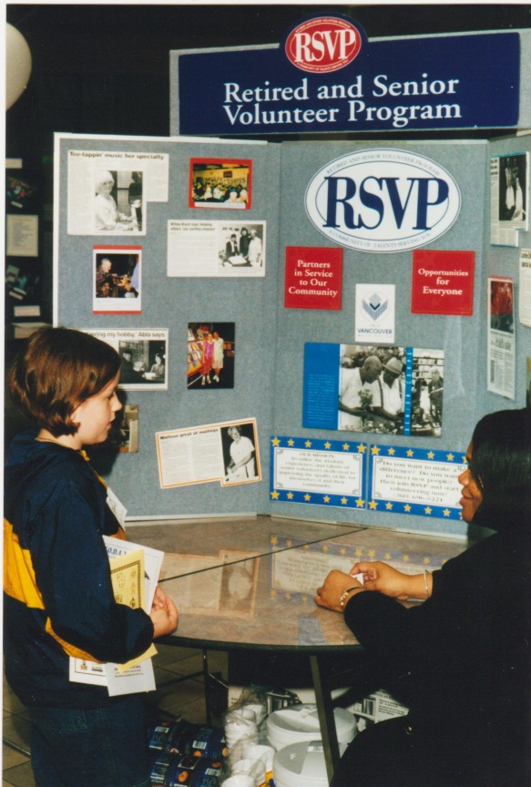
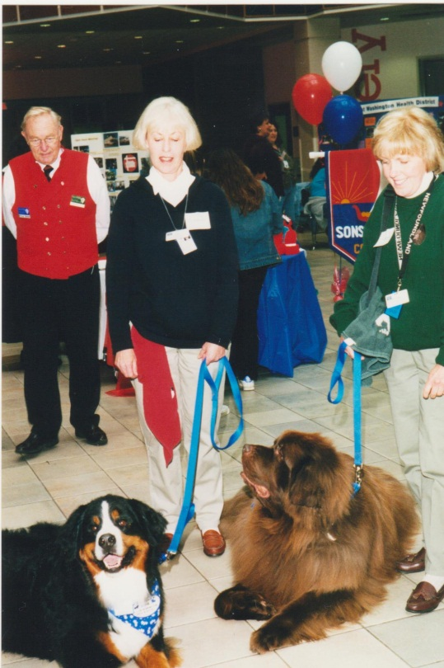
SHE LOVED BRINGING THE COMMUNITY TOGHETHER!

Slide 6
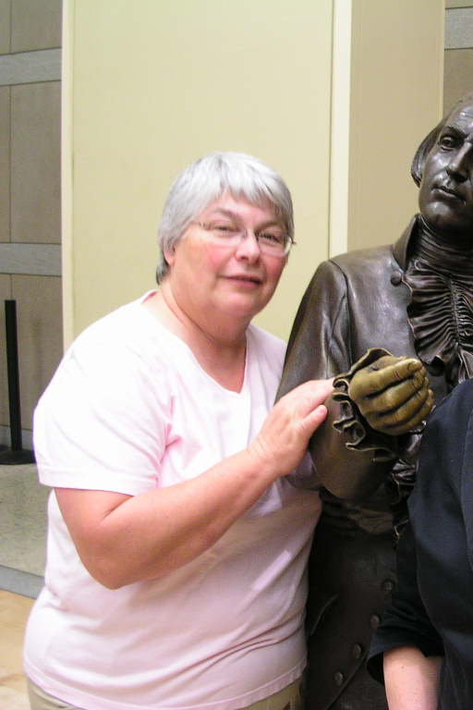
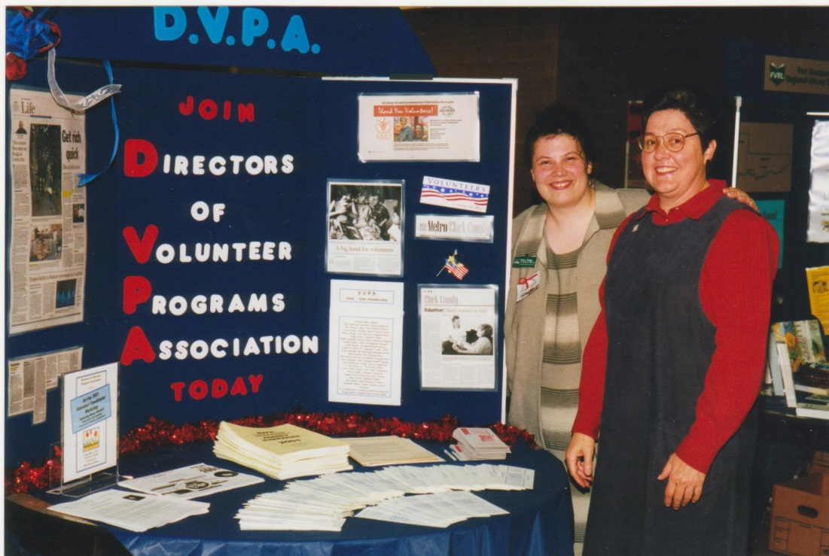
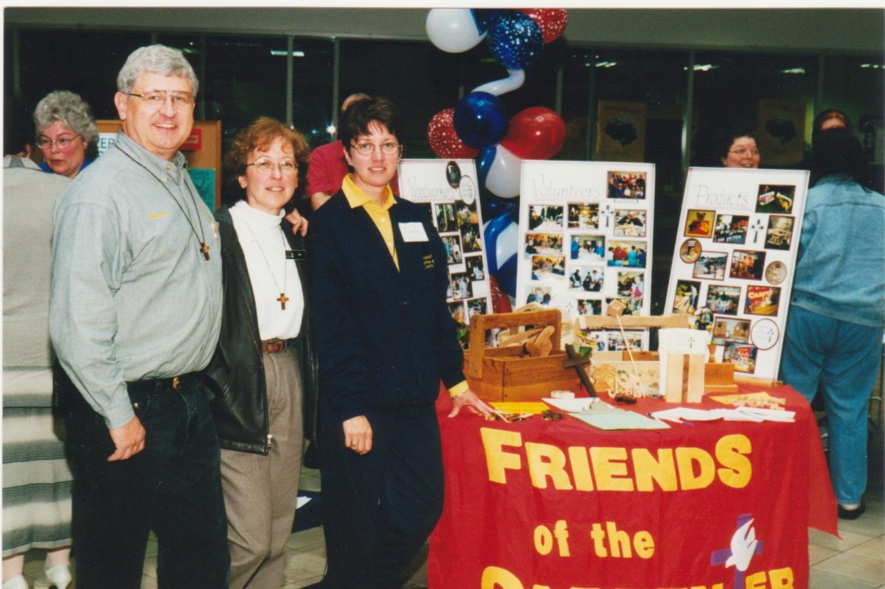
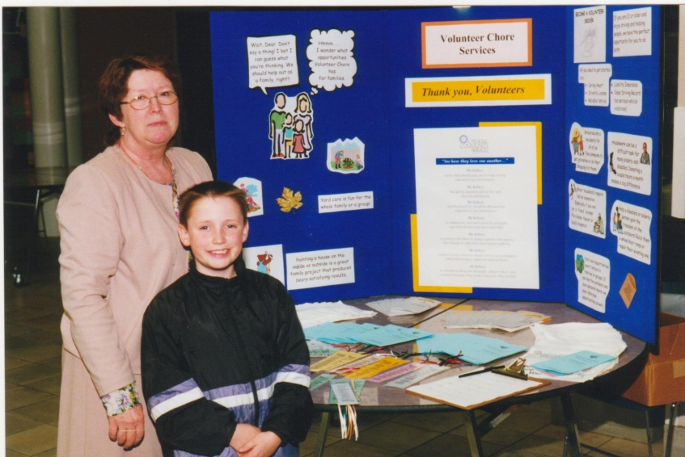

Slide 7
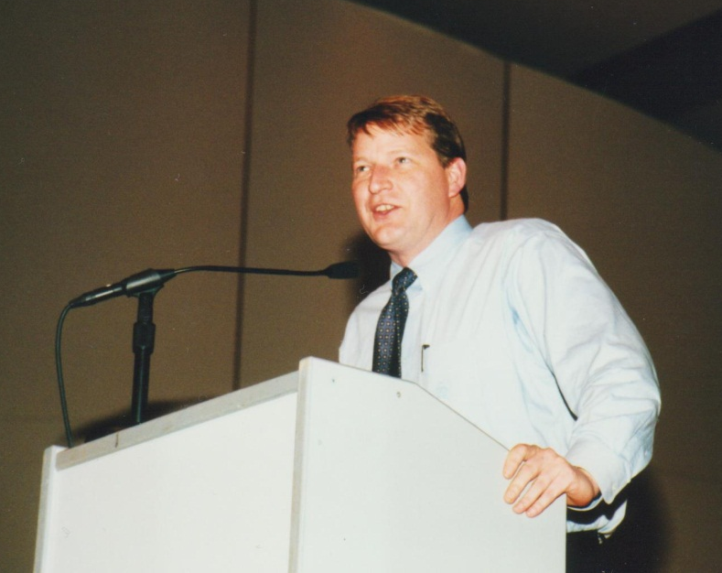
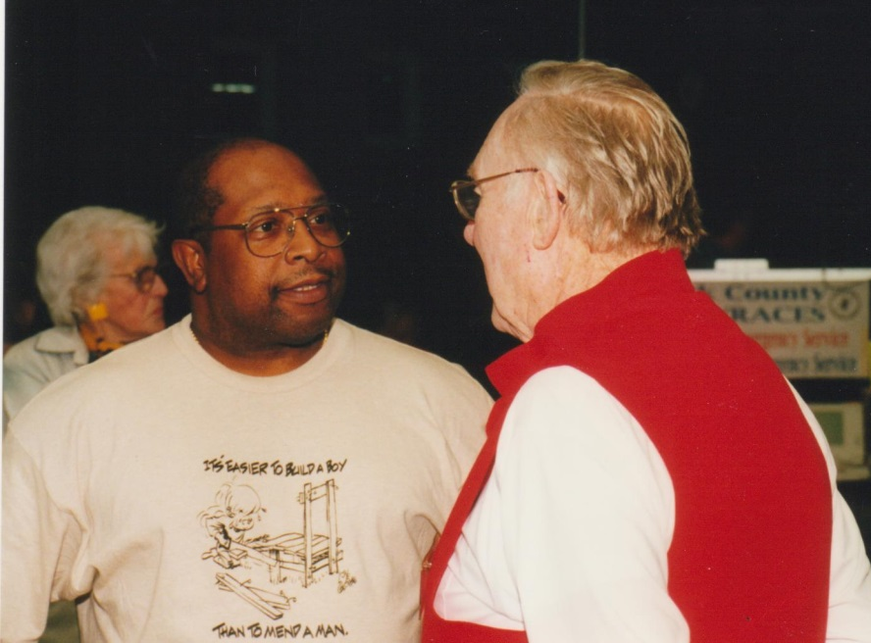
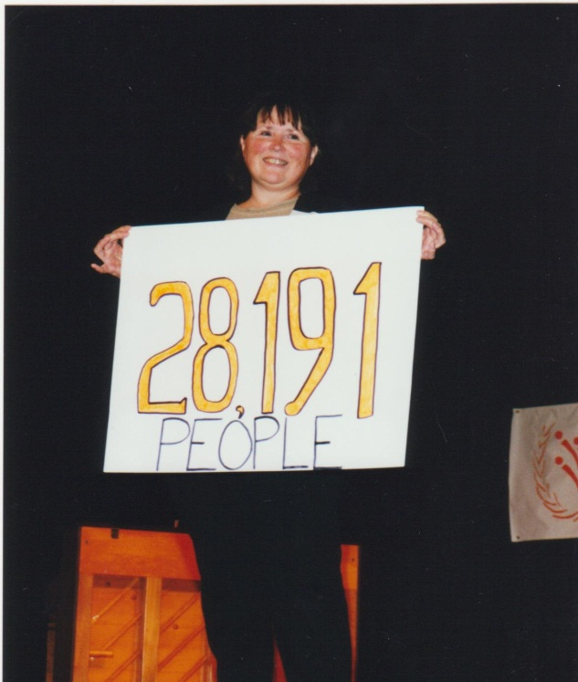
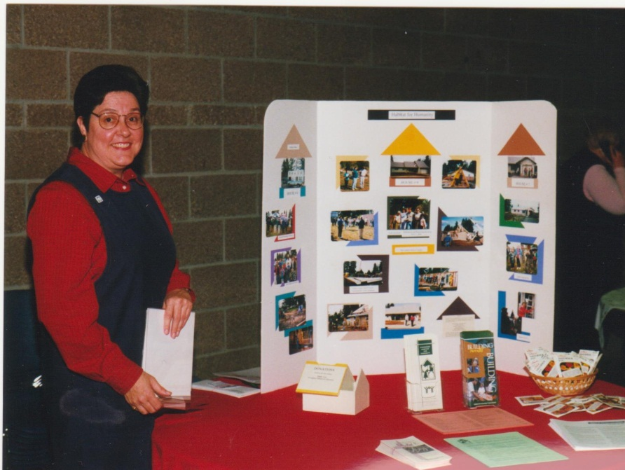
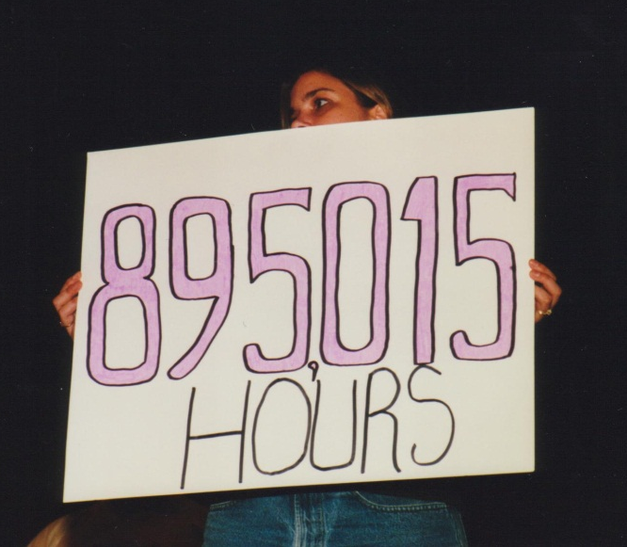
ANNE ALWAYS FOUND WAYS TO SHOWCASE
VOLUNTEERISM

Slide 8
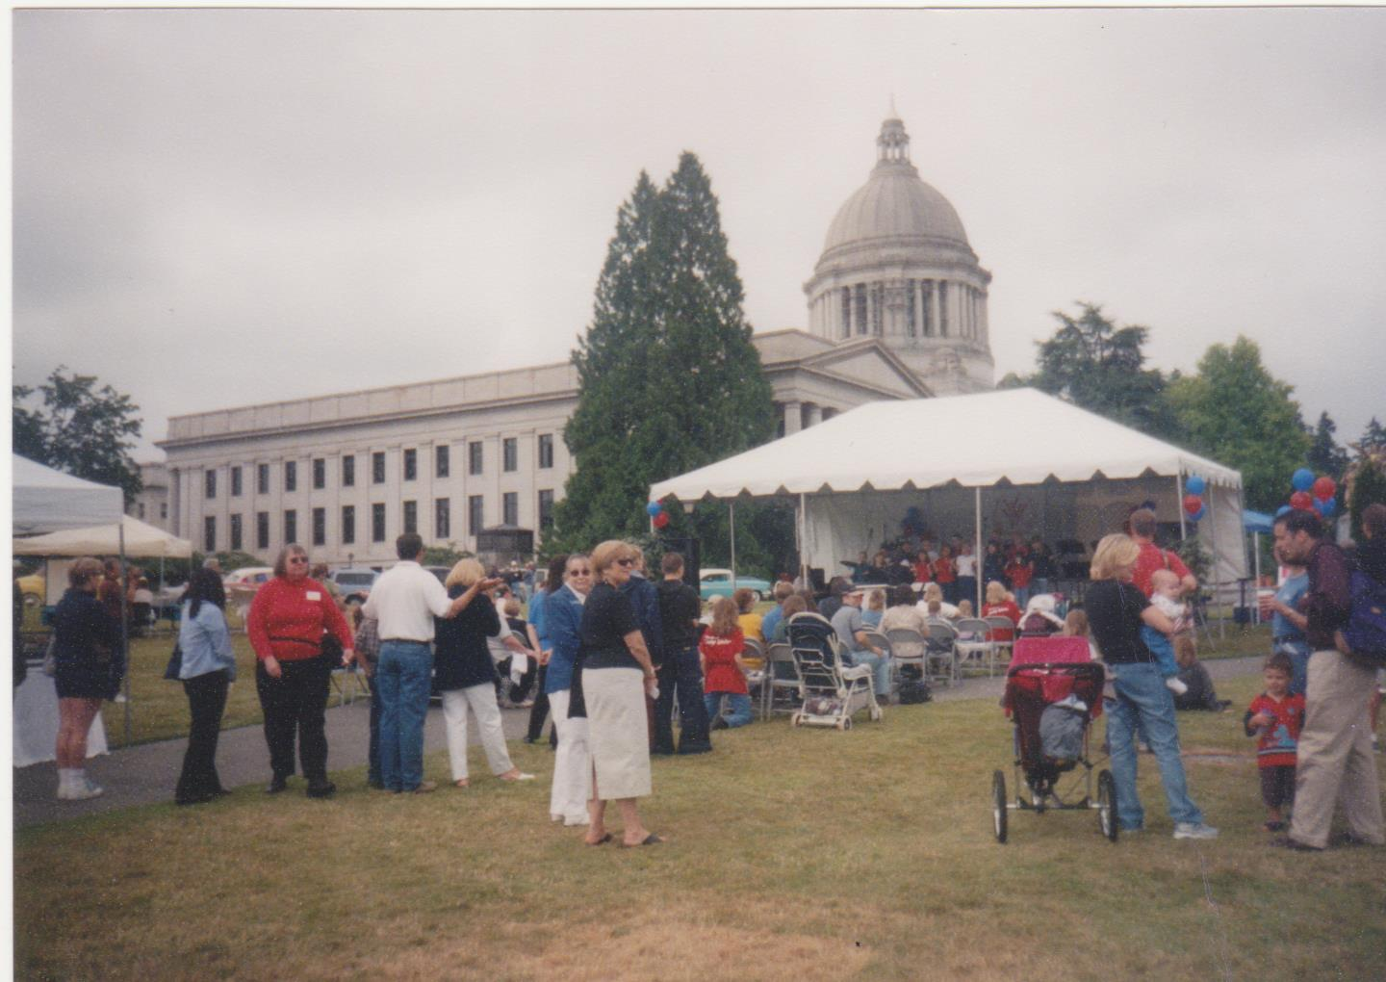
In 2001, the INTERNATIONAL YEAR OF THE VOLUNTEER Anne helped to coordinate a statewide event in Olympia

Slide 9
2010 Anne Turner Award Recipient:
Lisa Beranek, CPU Stream Team

Slide 10
2011 Anne Turner Award Recipient: Kris Henrickson, Clark County Teen Talk & Al Flory, YWCA

Slide 11
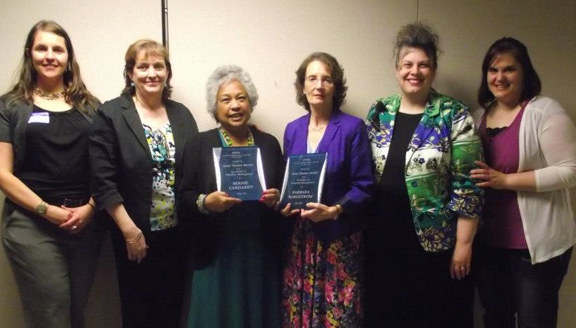
2012 Anne Turner Award Recipients:
Bernie Gerhardt, AFS &
Barbara Nordstrom, VPS Lunch Buddies/
VPS Foundation

Slide 12
2013 Anne Turner Award Recipients:
Kelly Cheney, VPD Volunteers in Police Service
Janell Watt, Portland Habitat for Humanity Re-Stores
Heidi Hiatt, YWCA & Mariah Acton, Columbia Springs

Slide 13
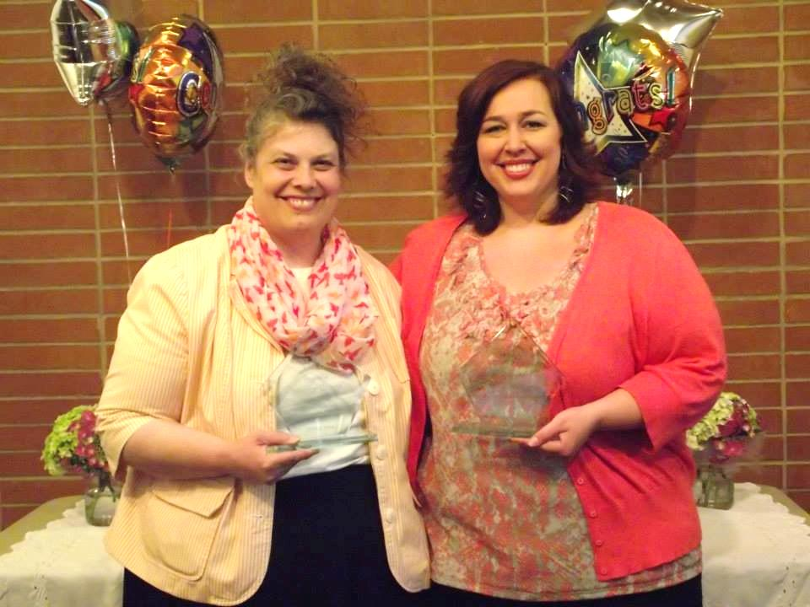
2014 Anne Turner Award Recipients: Sherry Braga, Fort Vancouver Regional Library District (FVRL) & Jeanne Phipps, The Volunteer Center & RSVP

Slide 14
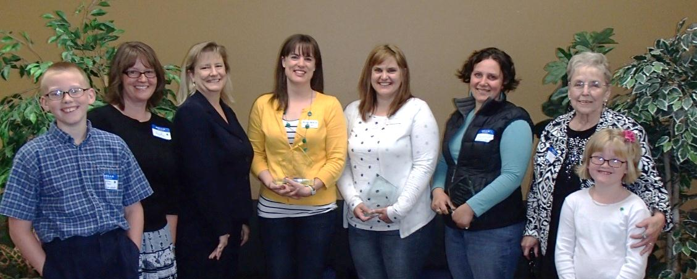
ANNE TURNER
A CHAMPION FOR VOLUNTEERISM
A CHAMPION FOR THOSE THAT COORDINATE VOLUNTEERS
AND A CHAMPION VOLUNTEER HERSELF
A FRIEND TO ALL

Slide 15
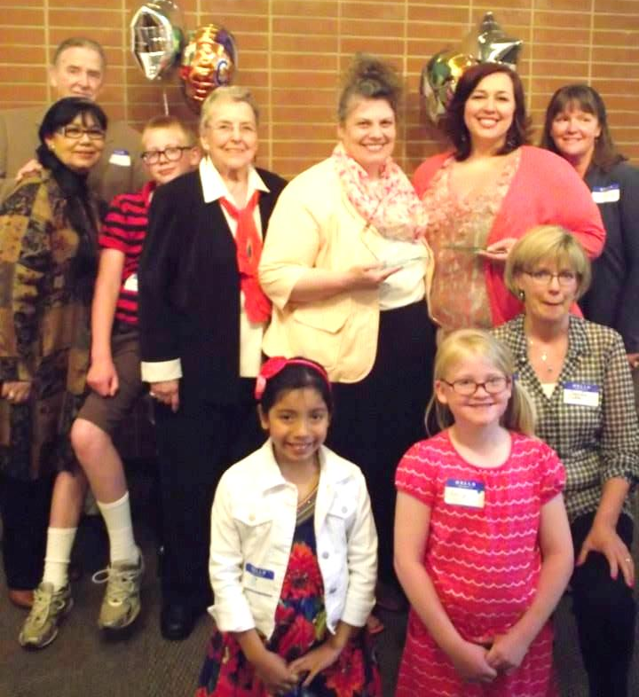
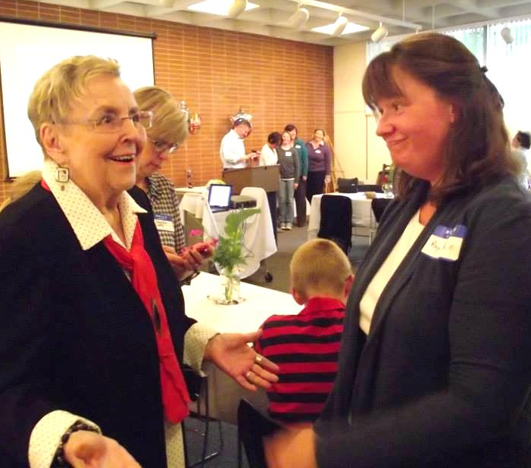
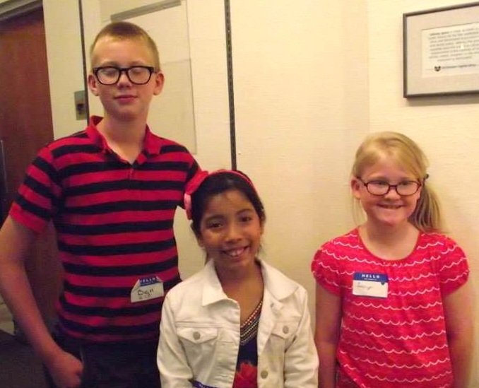
In 2013, DVPA was honored to have Anne Turner’s Family join DVPA’s Award Selection Committee

Slide 16
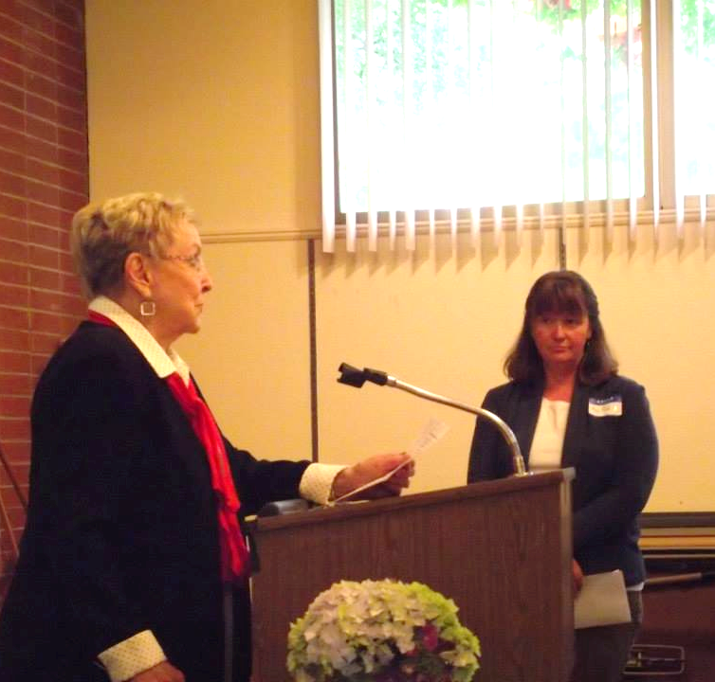
Please welcome Anne’s daughter’s, Anje & Jennifer…. as they present the 2015 Anne Turner Awards

Slide 17
We now present the
2015
Anne Turner Award for
Excellence in Volunteer Management

